Slide 1

136TH RTI MEDICAL SUPPORT SMART BOOK

Slide 2
TABLE OF CONTENTS
SUPPORT MEDIC DUTIES
REQUIRED ITEMS FOR OFF-SITE TRAINING
MEDICAL SOP BINDER
AID BAG INSPECTION
WET BULB SET UP/READING INSTRUCTIONS
WORK/REST CYCLES AND UNIFORM DOWNGRADE
PAST MEDICAL HISTORY QUESTIONS
MEDICATIONS: USAGE AND DOSAGE
DEHYDRATION/HEAT INJURY: SIGNS/SYMPTOMS/TREATMENT/PREVENTIVE MEASURES
COLD INJURY: SIGNS/SYMPTOMS/TREATMENT
SHOCK: SIGNS/SYMPTOMS/TREATMENT
RHABDOMYOLYSIS: SIGNS/SYMPTOMS/TREATMENT
ENVIRONMENTAL TREATMENTS
BODILY INJURY TREATMENTS
EVACUATION PROCEDURES

Slide 3
SUPPORT MEDIC DUTIES
Ensure aid bag is fully stocked, and all medical equipment is functional.
Keep track of medical SOP binder at ALL times.
Prepare ice sheets/coolers
Maintain wet bulb, record hourly findings in the SOP binder.
Assist with PCC/PCI checks before and during missions to ensure Soldiers have proper hydration sources, and all required medications.
Inquire about ALL previous medical history during inprocessing.
Record ALL medical issues: Profile, injuries, illnesses, allergies, medications, special diets on spreadsheet and place in back of SOP binder.
Routinely check on Soldiers AND cadre during training events. (Every hour or so dependent on training conditions).
Ensure Soldiers are eating and staying hydrated. Monitor for heat/cold weather injuries, especially during major training events.
Fully understand treatment options and evacuation plans as detailed in medical SOP and support smart book.
While on medical support, be readily available at ALL times. Instructors and cadre should know where you are in the event of an emergency.

Slide 4
REQUIRED ITEMS FOR FIELD/OCS/WOCS TRAINING
Medical SOP Binder
Aid Bag – fully stocked
Wet Bulb
Litter/Sked
Casualty blankets
Ice Sheets/Cooler

Slide 5
MEDICAL SOP BINDER
The Medical SOP binder must be present during all off-site training events. Medical support personnel should familiarize with this book upon receiving. This binder includes the following:
-- Evacuation locations, phone numbers, facilities, strip maps.
-- Ambulance Exchange points
-- Medical documentation: Sick call slips, SF 600’s, LOD
-- Wet Bulb tracker
-- Environmental threats

Slide 6
AID BAG INSPECTION
Ensure aid bag is thoroughly inventoried upon receiving. A packing list is included.
Inspect expiration dates of all medications and IV supplies (to include needles).
Verify condition and functionality of all vital signs equipment.
-- If aid bag supplies are low, missing (to include medications), or not working properly, inform Branch Chief or Course Manager ASAP to get restocked.

Slide 7
WET BULB
It is the responsibility of the medical personnel at training sites to ensure the wet bulb is set up and maintained correctly.
Per command team, it is mandatory that hourly measurements of wet bulb globe temperature (WBGT) are conducted when ambient temperature is over 70 ºF. Wet bulb temperature and heat category must be logged in Medical SOP binder.
**** Wet bulb is only required in an outside training environment.

Slide 8
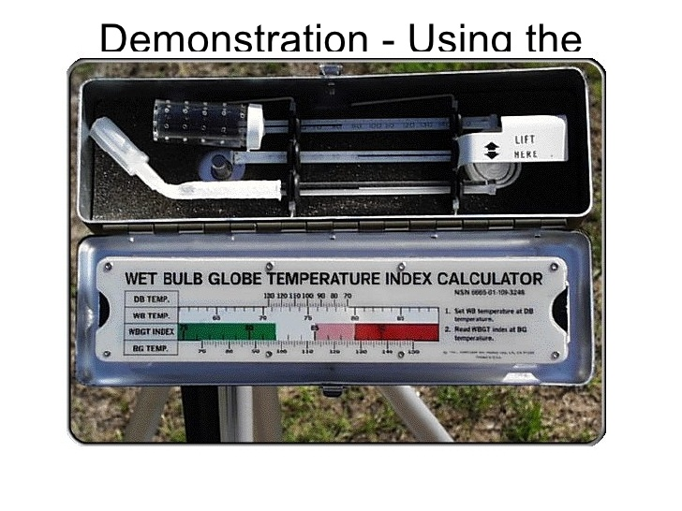
WET BULB

Slide 9
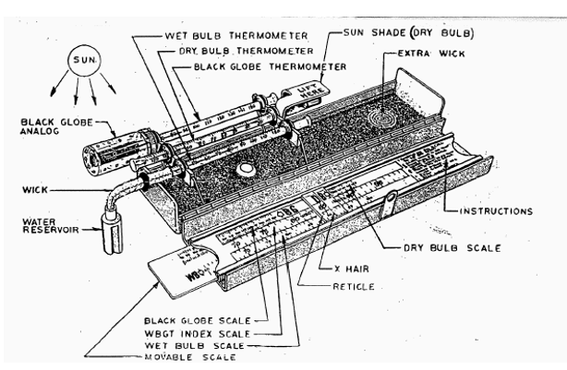
WET BULB

Slide 10
WET BULB SET UP
The wet bulb contains three different thermometers:
1) The stationary wet bulb (WB) thermometer, with the bulb covered by a moistened, white absorbent wick, is exposed to the sun and prevailing wind.
2) A similarly exposed "black globe" (BG) thermometer, with copper sheath painted black, that is enclosed in a perforated shield.
3) A dry bulb (DB) thermometer, with bulb shielded from the direct rays of the sun by an aluminum shield.
SET UP INSTRUCTIONS:
(1) Wet the bulb wick thoroughly. NOTE: The little bottle should be filled with clean, preferably deionized or distilled water.
(2) Hold the kit with thermometers toward the sun, with the "black globe" thermometer closest to the sun. Wait 10 minutes for stabilization of temperatures.
(3) Review instructions on face of the slide ruler assembly. Assume for purposes of instruction that BG reading is 120, DB reading is 100, and WB reading is 80:
(a) Move 70 on BG scale to 70 on WBGT scale.
(b) Slide X-hair to 120 on BG scale.
(c) Move 70 on DB scale under X-hair.
(d) Slide X-hair to 100 on DB scale.
(e) Move 70 on WB scale under X-hair.
(f) Slide X-hair to 80 on WB scale.
(g) Read WBGT index. NOTE: If calculations have been performed correctly, the index should read 90

Slide 11
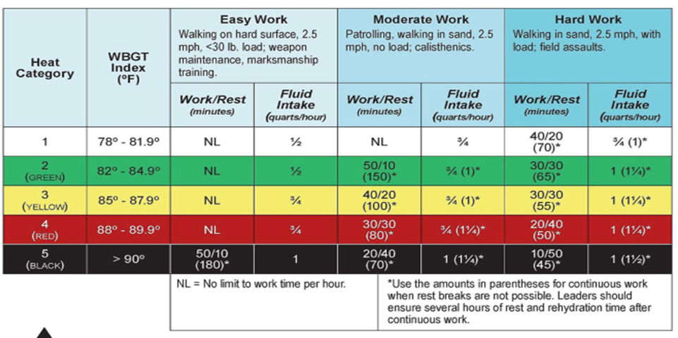
WORK/REST CYCLES AND FLUID REPLACEMENT

Slide 12
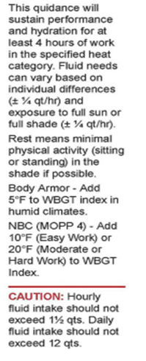
WORK/REST CYCLES AND FLUID REPLACEMENT

Slide 13
HEAT CATEGORY DOWNGRADE
Heat CAT I,II, and III: normal activity, no changes in uniform
Heat CAT IV: downgrade gear (as approved by command)
Heat CAT V: Downgrade gear, unbutton sleeves, unblouse pants
**** All of the above is subject to Command discretion and Unit SOP’s.

Slide 14
PAST MEDICAL HISTORY QUESTIONS
Prior to training events, medical personnel are REQUIRED to inquire about all trainee’s past and current medical history.
Questions that should be asked:
Prior heat/cold weather casualty
Any training related injuries, or history of repeat injuries
Current or previous profiles (regardless of nature of illness or injury)
Current or previous allergies (medication/food/plants/animals/insects, etc)
Current medications, to include supplements and vitamins.
Current or recent illnesses (regardless of nature)
EMPHASIZE NEED FOR MEDICAL HISTORY IN THE EVENT AN INJURY OR ILLNESS OCCURS AND WE HAVE TO ADMINISTER MEDICATION!
ALL ANSWERS SHOULD BE RECORDED IN THE SOP BINDER IN THE EVENT OF TRAINING ACCIDENT/INJURY/ILLNESS.

Slide 15
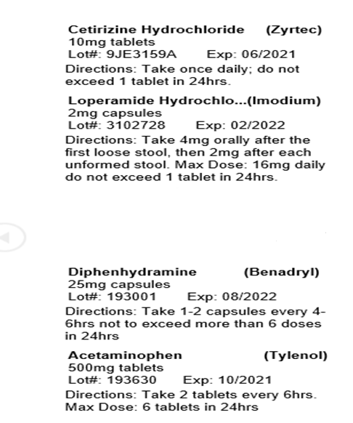
MEDICATIONS: BLACK BOX

Slide 16
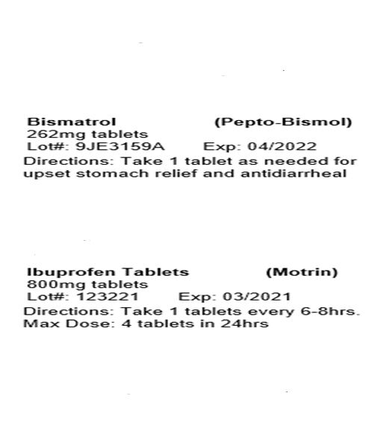
MEDICATIONS

Slide 17
Additional Medications
Inhaler: For inhalation aerosol dosage form (inhaler):For treatment or prevention of bronchospasm:
Adults and children 4 years of age and older—Two puffs every 4 to 6 hours as needed.
Epi-Pen: EpiPens are indicated in the emergency treatment of allergic reactions including anaphylaxis.
Inject EpiPen intramuscularly or subcutaneously into the anterolateral aspect of the thigh, through clothing if necessary. Each device is a single-use injection.

Slide 18
DEHYDRATION, HEAT INJURY, HEAT CASUALTY SIGNS/SYMPTOMS
Dehydration/Heat injury:
Early stage signs/symptoms: Thirst, dry mouth, dizziness, slight nausea, headache, muscle weakness, red/dry skin, passing less urine (or no urge to urinate), and tiredness are all common for mild or moderate dehydration/heat injury.
Late stage symptoms: Rapid breathing, no longer sweating, no urine output/dark yellow urine, nausea, vomiting, diarrhea, rapid heartbeat, sunken eyes, confusion, irritability, altered mental status, or fainting are all common for more severe dehydration/heat injury.
Heat Casualty:
Significant drop in blood pressure, high core temp (rectal), dizziness, nausea headache, rapid heart beat, confusion, red/dry/damp skin, coma, internal damage, death.

Slide 19
PREVENTIVE MEASURES
Knowledge of prior heat related illnesses or injuries.
Marking soldiers with appropriate tabs on uniform to easily identify.
Ensure Soldiers have adequate amounts of food and water available before, and during all training events.
Advise hydrating the day/night prior to a major training event or field exercise.
Advise avoidance or limitation of drinks with caffeine, or alcohol prior to training events.

Slide 20
DEHYDRATION/HEAT INJURYTREATMENT
Early stages:
OBTAIN VITAL SIGNS
Encourage drinking water slowly if able to be kept down.
Rehydration salts pack (cerasport/drip drop, etc) in canteen or bottle of water.
Unblouse pants/jacket
Rest in shaded area if possible
Middle stages:
Unblouse pants/jacket or remove jacket
Move to shaded area or air conditioned vehicle
OBTAIN VITAL SIGNS
If able to drink fluids, encourage.
If unable to drink or hold down fluids, (if determined dehydration) fluids can be administered: 500mL/1000mL Normal Saline. Reevaluate after fluids are given. (AVOID Lactated Ringers due to potential Rhabdomyolysis)
Severe stage (loss of consciousness/passing out/altered mental status):
Get to shaded area or air conditioned vehicle immediately
OBTAIN VITAL SIGNS (RECTAL temperature for baseline in this situation)
Cold packs in groin, neck, armpits to aid in cooling body temperature.
If deemed necessary, (AND NOT IN AN AIR CONDITIONED ENVIRONMENT) apply ice sheets until body temperature is regulated
Administer 1000mL normal saline
EVACUATE for further treatment

Slide 21
COLD INJURY SIGNS/SYMPTOMS
Chilblain, Immersion foot, Frostnip, Frostbite:
Numbness and tingling
Burning and severe pain
White to blue discoloration of the skin
Redness and swelling of the affected part
Blisters, erosions and ulcers
Necrosis and gangrene
Loss of function of the affected part

Slide 22
COLD INJURY TREATMENT
Preventing further heat loss and exposure to cold by dressing the site, using appropriate clothing and providing insulation.
Restoring or improving blood flow slowly by using warmth
Increasing oxygen perfusion (oxygen therapy, if available)
Preventing infections and other injuries to the damaged area by administering antibiotics, dressing the wound and avoiding use of the affected area.
EVACUATE for further treatment.

Slide 23
SHOCK SIGNS/SYMPTOMS
Causes of Shock may include: Significant blood loss, heart failure, dehydration, severe and painful blows to the body, severe burns, severe wound infection, allergic reactions.
Early signs of shock: Cold/clammy skin, excessive sweating, rapid pulse, enlarged pupils, elevated blood pressure, fast/shallow breathing.
Late signs of shock: Tachycardia or bradycardia, low blood pressure, poor capillary refill, altered mental status, irregular breathing pattern, poor muscle tone, loss of consciousness, death.

Slide 24
SHOCK TREATMENT
If you suspect a person is in shock, call 911 or your local emergency number. Then immediately take the following steps:
Lay the person down
Keep the person still and don't move him or her unless necessary.
Begin CPR if the person shows no signs of life, such as not breathing, coughing or moving.
Loosen tight clothing and cover the person with a blanket to prevent chilling.
Don't let the person eat or drink anything.
If the person vomits or begins bleeding from the mouth, and no spinal injury is suspected, turn him or her onto a side to prevent choking.
EVACUATE IMMEDIATELY!

Slide 25
RHABDOMYOLYSIS
Skeletal muscle damage due to several causes including excessive use, heat burn, and crush injury and certain medications. Muscle damage leads to release of proteins (myoglobin) into the bloodstream. Rhabdomyolysis can cause muscle pain, weakness, and kidney failure. Medication and treatment procedures are chosen based on the severity.
Exertional rhabdomyolysis may occur without elevations in body core temperature or brain dysfunction but frequently occurs as part of the clinical syndromes of severe heat casualty.
Exertional rhabdomyolysis is caused by skeletal muscle damage with release of cellular contents into the blood circulation, including myoglobin, potassium, phosphate, creatine kinase, and uric acid. Rhabdomyolysis is incorporated in the diagnosis of heat injury.
The “classic triad” of rhabdomyolysis symptoms are: muscle pain in the shoulders, thighs, or lower back; muscle weakness or trouble moving arms and legs; and dark red or brown urine or decreased urination. Keep in mind that half of people with the condition may have no muscle-related symptoms.

Slide 26
RHABDOMYOLYSIS TREATMENT
There is currently no field test to identify Rhabdomyolysis, however, this illness is becoming more common.
If suspected Rhabdomyolsis: EVACUATE!
DO NOT PUSH FLUIDS OR ADMINISTER MEDICATIONS!!!!!!!!

Slide 27
ENVIRONMENTAL TREATMENTS
ALLERGIC REACTIONS
Bug Bites: For bites that itch, apply an ice pack or an over-the-counter anti-itch cream, such as hydrocortisone. Another option is to take an over-the-counter oral antihistamine (Benadryl/Zyrtec). To reduce swelling, apply an ice pack to the bite.
Poison Ivy/Oak: Apply cool compresses to the skin. Use topical treatments to relieve itching, including calamine lotion. Oral antihistamines, such as diphenhydramine (Benadryl), can also help relieve itching.
***Always check for allergies before administering ANY medications, and advise that Benadryl may cause drowsiness

Slide 28
BODILY INJURIES
ORTHOPEDIC INJURIES:
Blisters: Make sure socks stay dry, apply moleskin to affected area. Do not pop.
Strains/Sprains: Keep boots tight. Ace bandage for stability and to limit swelling. Ice packs.
Fractures/Breaks: Stabilize and evacuate.
BURNS: Cover burn area with dry, sterile dressing. For extensive burns consider blizzard blanket for prevention of hypothermia. Evacuate.
EYE INJURIES: Stabilize. Do not remove object, if penetrating. Flush eye if object is removable. Evacuate.
CRUSH INJURIES: Stabilize (if able) and evacuate.

Slide 29
EVACUATION PROCEDURES
FORT HOOD:
LOCATION: Darnall Army Medical Center
ADDRESS: 36065 Santa Fe Ave, Fort Hood Texas 76544
PHONE NUMBER: 254-288-8000
RANGE CONTROL: 254-287-3130/254-287-3321
CAMP SWIFT:
LOCATION: St. Davids Emergency Center
ADDRESS: 3201 TX-71, Bastrop Texas 78602
PHONE NUMBER: 512-308-5900

